Slide 1
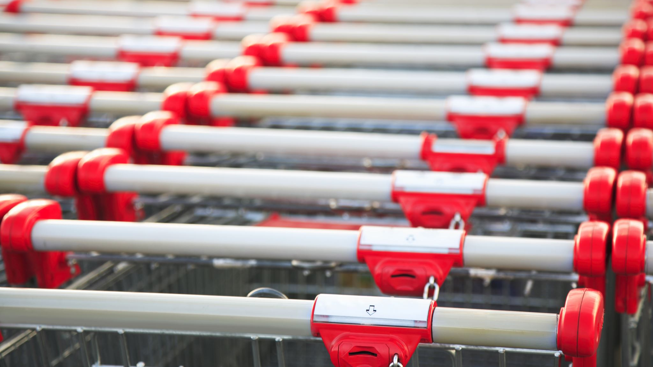
Milkbasket Metrics Analysis
Created FOR MILKBASKET

Slide 2
RFM ANALYSIS
WE HAVE CALCULATED THE NUMBER OF CUSTOMERS WHO HAVE CHURNED AND THOSE WHO ARE AT HUGE RISK OF BEING CHURNED.

Slide 3
Design
Loading the data
Building the dataset
And split the dataset into customer, order
Data Seggregation
Calculate RFM
Training a model and evaluating model performance
Plot the Data
Visualizing the RFM DataFrame
Modeling churn risk

Slide 4
DEMO
http://localhost:8888/notebooks/rfm-analysis.ipynb

Slide 5
TABLEAU VISUALIZATIONS
We have created various visualizations and identified business insights from them.

Slide 6
Design

Slide 7
DEMO

Slide 8
RECOMMENDATION ENGINE
WE HAVE TRAINED A COLLABORATIVE FILTERING BASED MODEL TO IDENTIFY THE PRODUCTS THAT CAN BE RECOMMENDED TO THE CUSTOMERS BASED ON THEIR PURCHASING HISTORY AS WELL AS THE PRODUCT AFFINITY

Slide 9
Design
Start
Data preparation
Create data with user, item, and target field
Load data
Create dummy (Dummy for marking whether a customer bought that item or not)
Normalize item values across users
Split train and test set
Define Models using Turicreate library
Popularity Model identified
ImplementCollaborative Filtering Model

Slide 10
DEMO
http://localhost:8888/notebooks/recommendation-MT.ipynb

Slide 11
AND ONE MORE THING

Slide 12
A SIMPLE ANDROID APP
THIS WORKS ON TOP OF THE RECOMMENDATION ENGINE MODEL AND DISPLAYS RECOMMENDED PRODUCTS TO THE CUSTOMER.

Slide 13
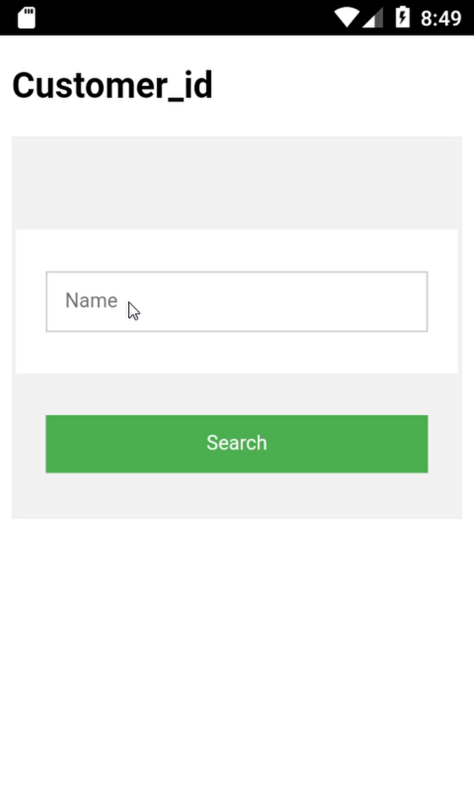
DEMO

Slide 14
DEVELOPED AND PRESENTED BY
JYOJITH
FARHAN
VAISAKH

